Slide 1

Does it matter?
High Availability, and Disaster Recovery in Serverless solutions.

Slide 2
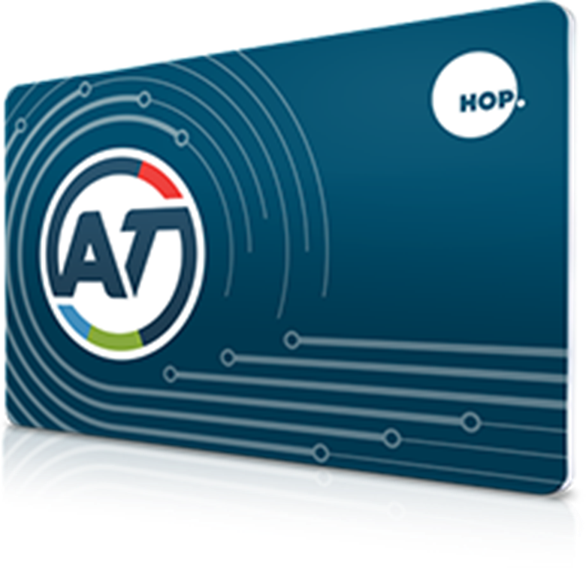





Presenter
Tariq Younas
Cloud Ops Support Eng./ Azure Stack Operator
@Tariq_Younas
http://tariq-younas.blogspot.co.nz
https://www.linkedin.com/in/TariqYounas

Slide 3
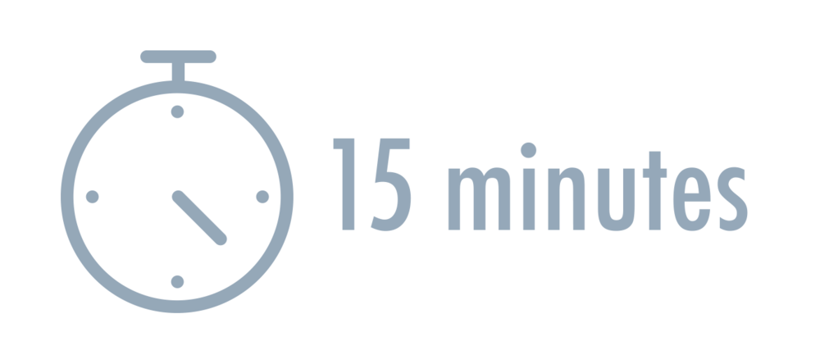
Agenda
Serverless
(DR/HA) Does it matter?
Serverless planning
Services selection

Slide 4


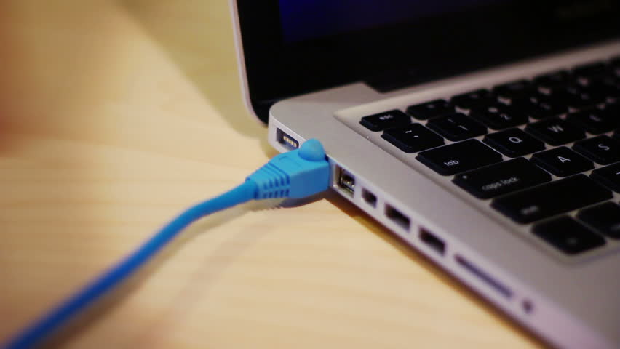

Slide 6


Slide 7
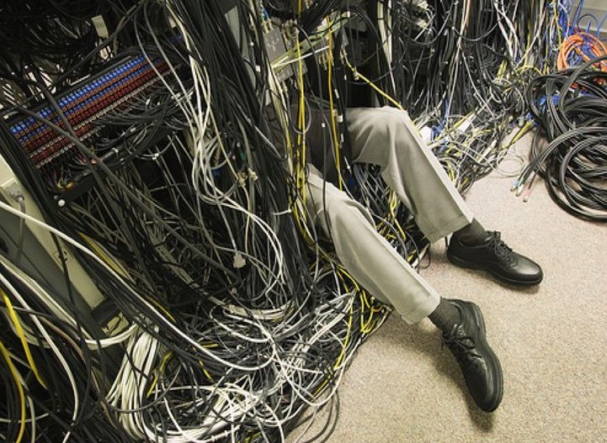

Slide 8
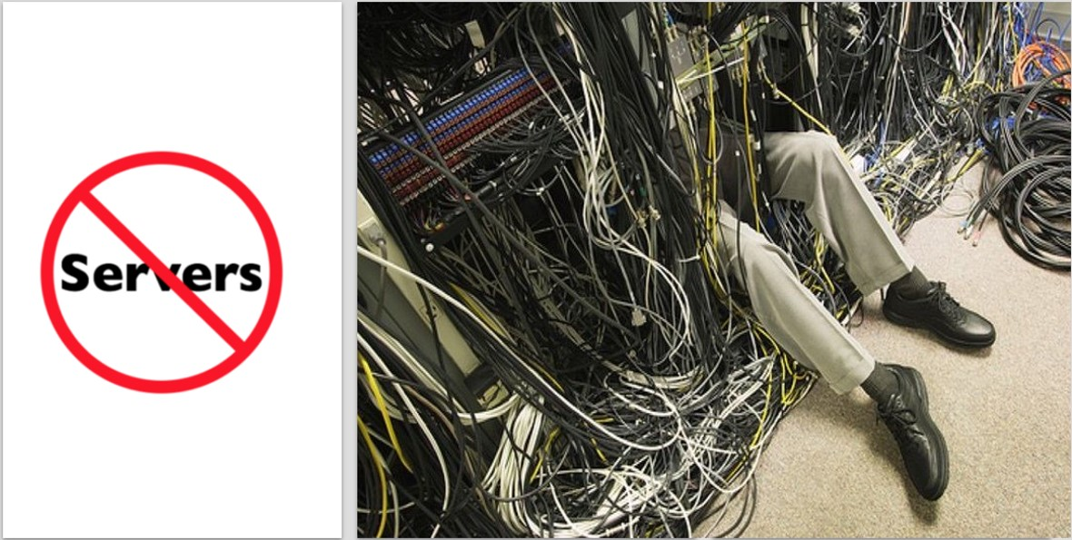
Serverless doesn't mean "no servers", it just means you don't have to care about them.

Slide 9
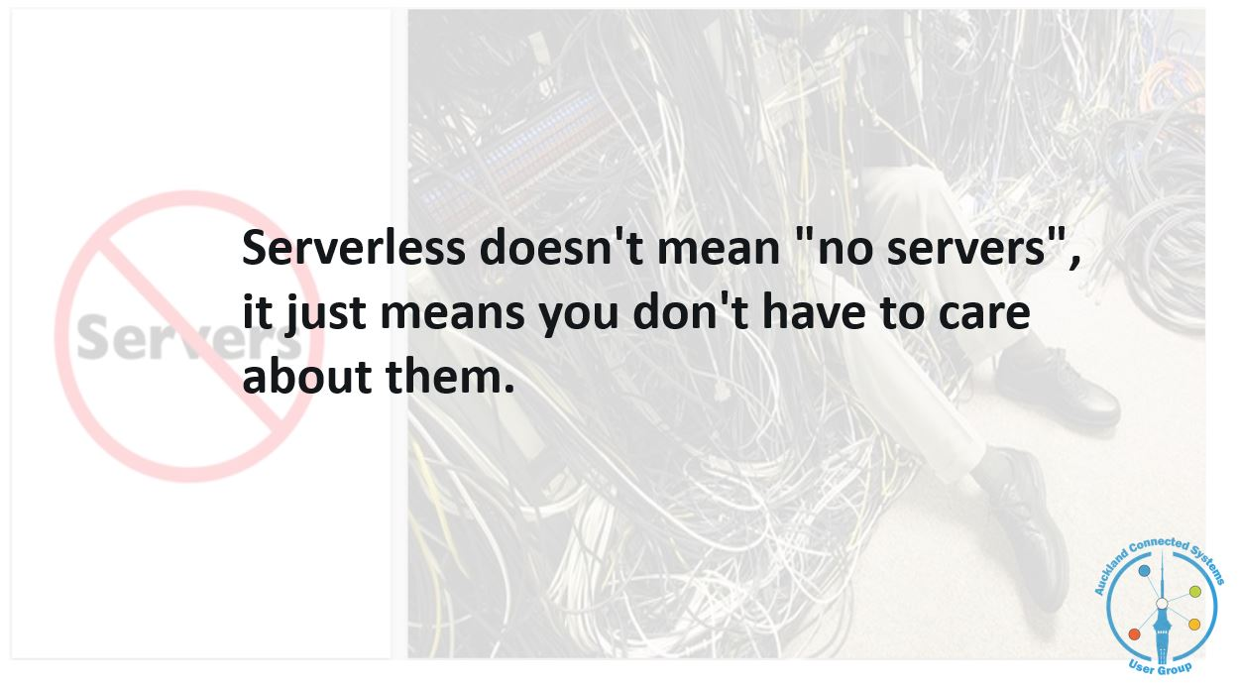


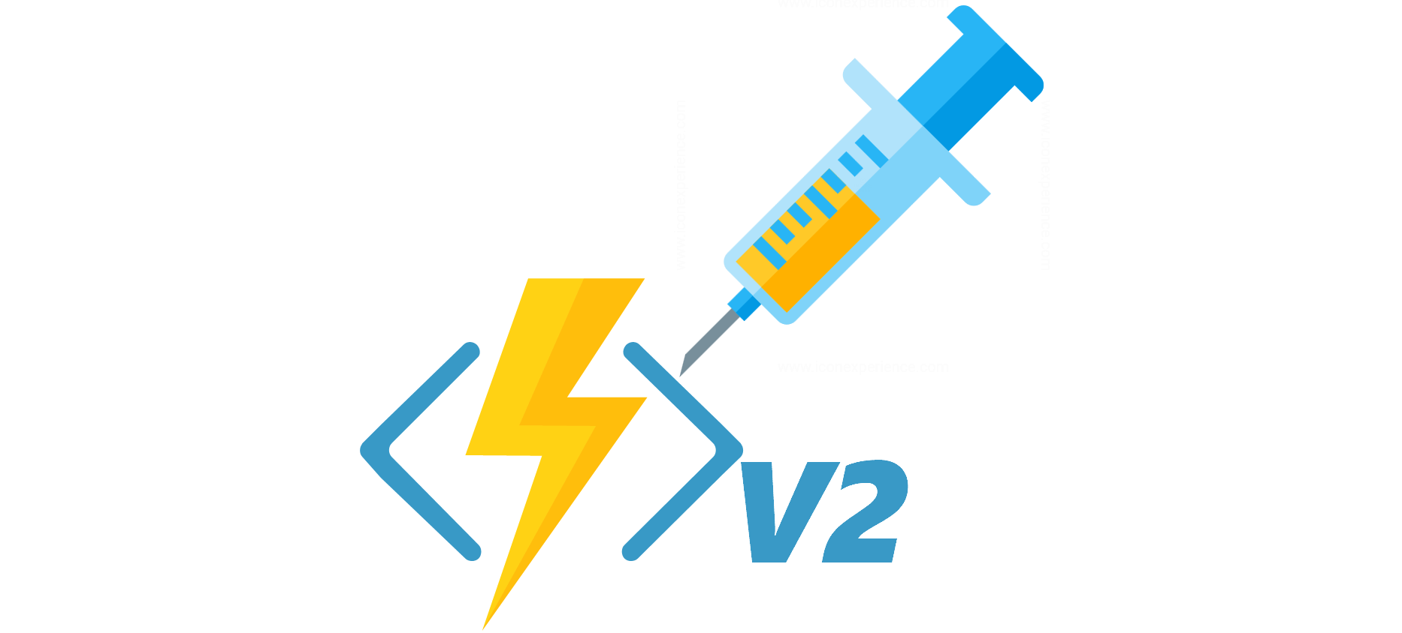

Slide 10
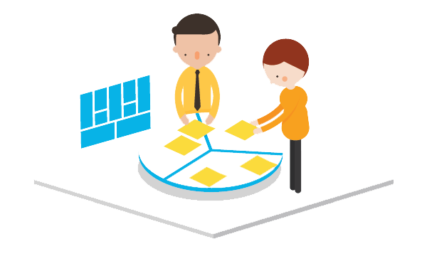

Slide 11
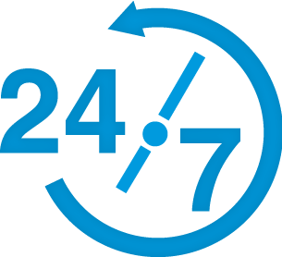
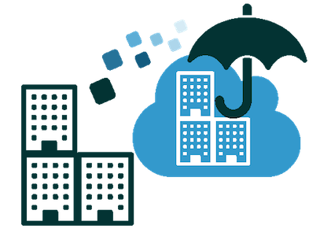
High Availability
Disaster Recovery

Slide 12
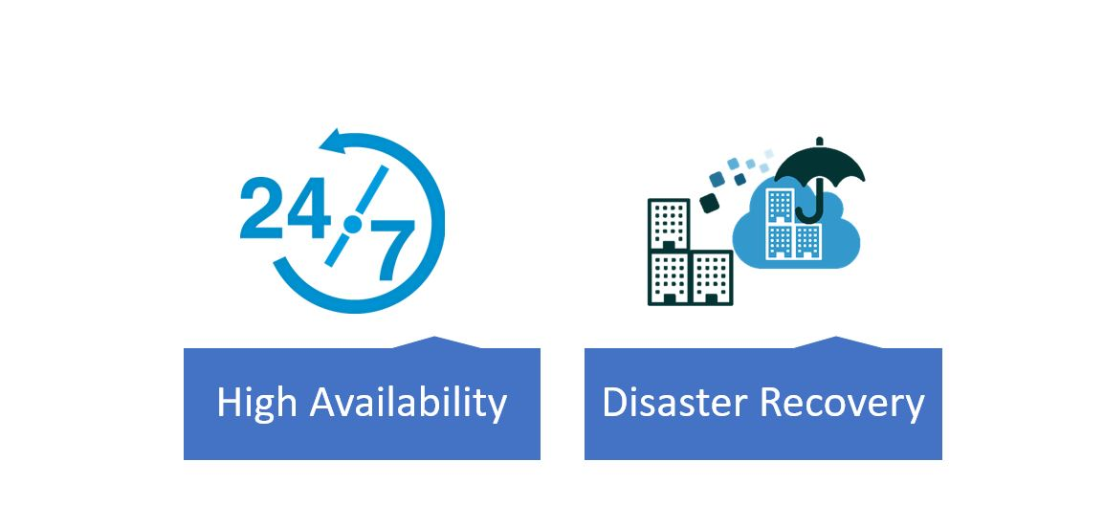

Slide 13

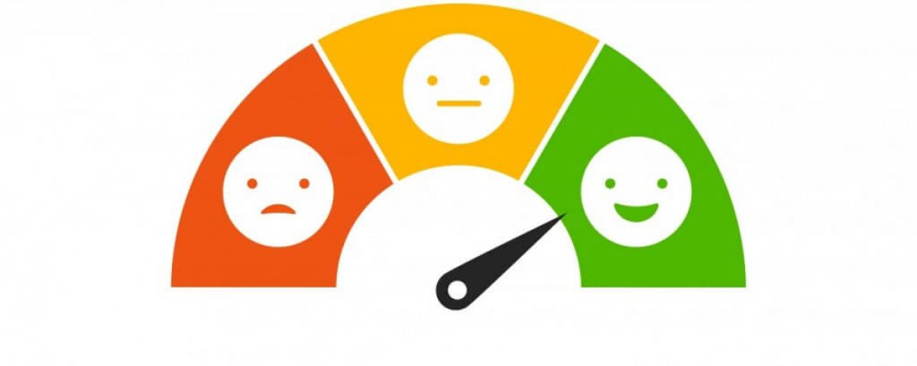
We don’t care; we are Serverless!

Slide 14
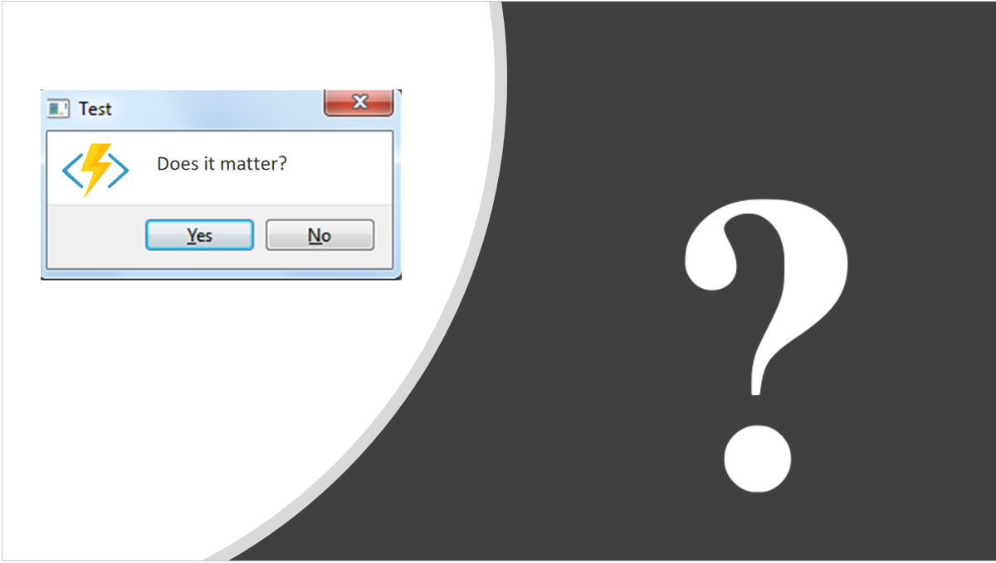

Slide 15

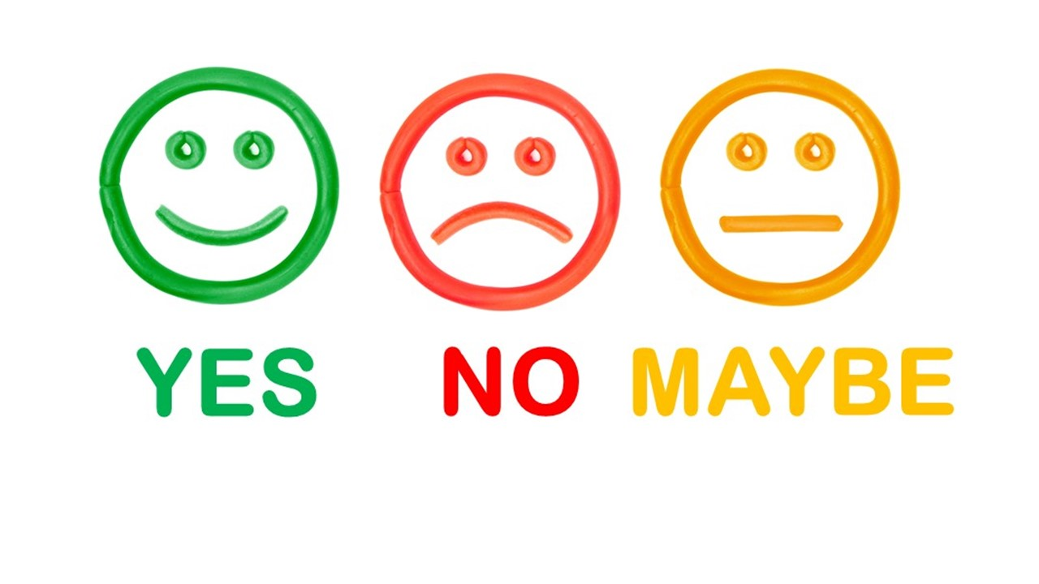


Slide 16
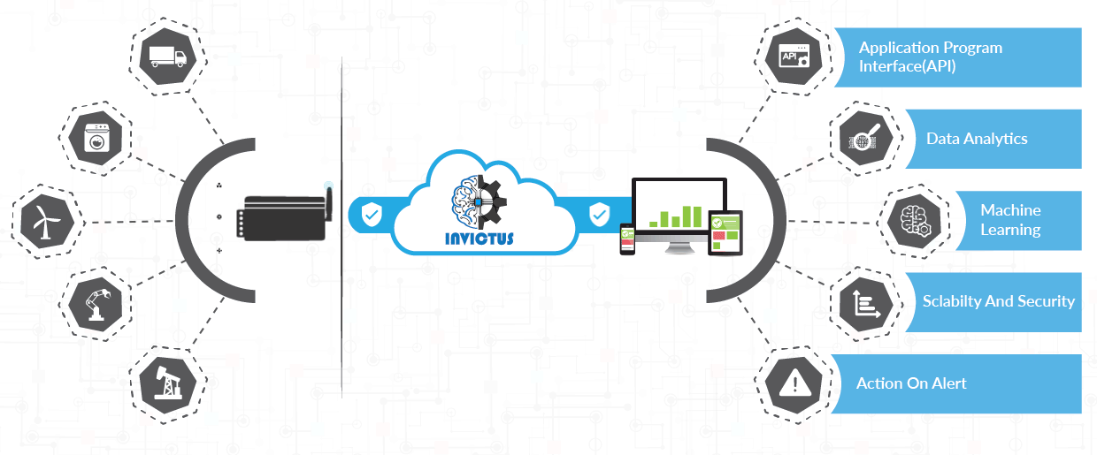
Mission Critical
Robust Solutions

Slide 17
Robust
Characteristics of a solution?
Reliability
Maintainability
Scalability

Slide 18
Robust
Characteristics of a solution?
Correctly in case of failures and faults
Maintainability
Scalability

Slide 19
Robust
Characteristics of a solution?
Correctly in case of failures and faults
Able to grow with same levels of performance
Scalability

Slide 20
Robust
Characteristics of a solution?
Correctly in case of failures and faults
Able to grow with same levels of performance
Organize itself to be productive and modifiable

Slide 21


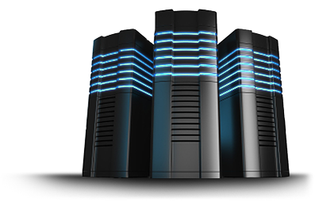

Slide 22
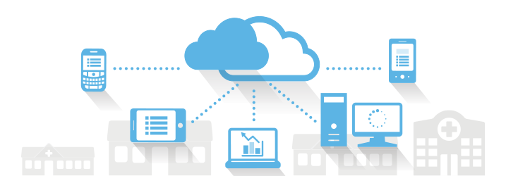

Slide 23
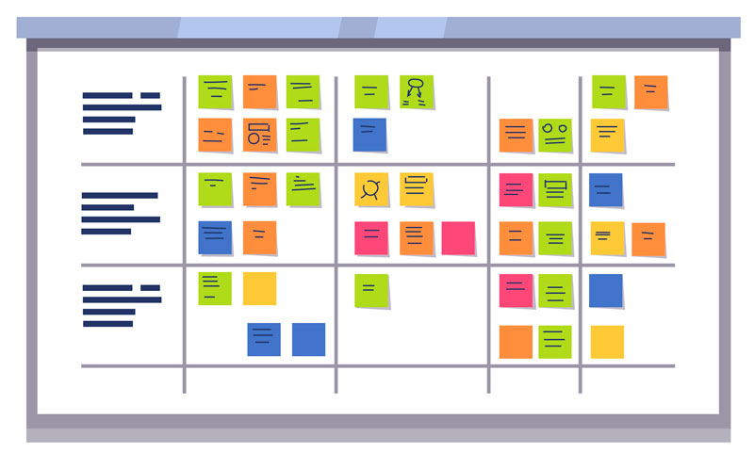

Slide 25
Ingestion EndPoint(s)
1
Storage
Storage
Security
Security
Availability & DR
Availability & DR
Serverless
Architecture - Planning

Slide 26
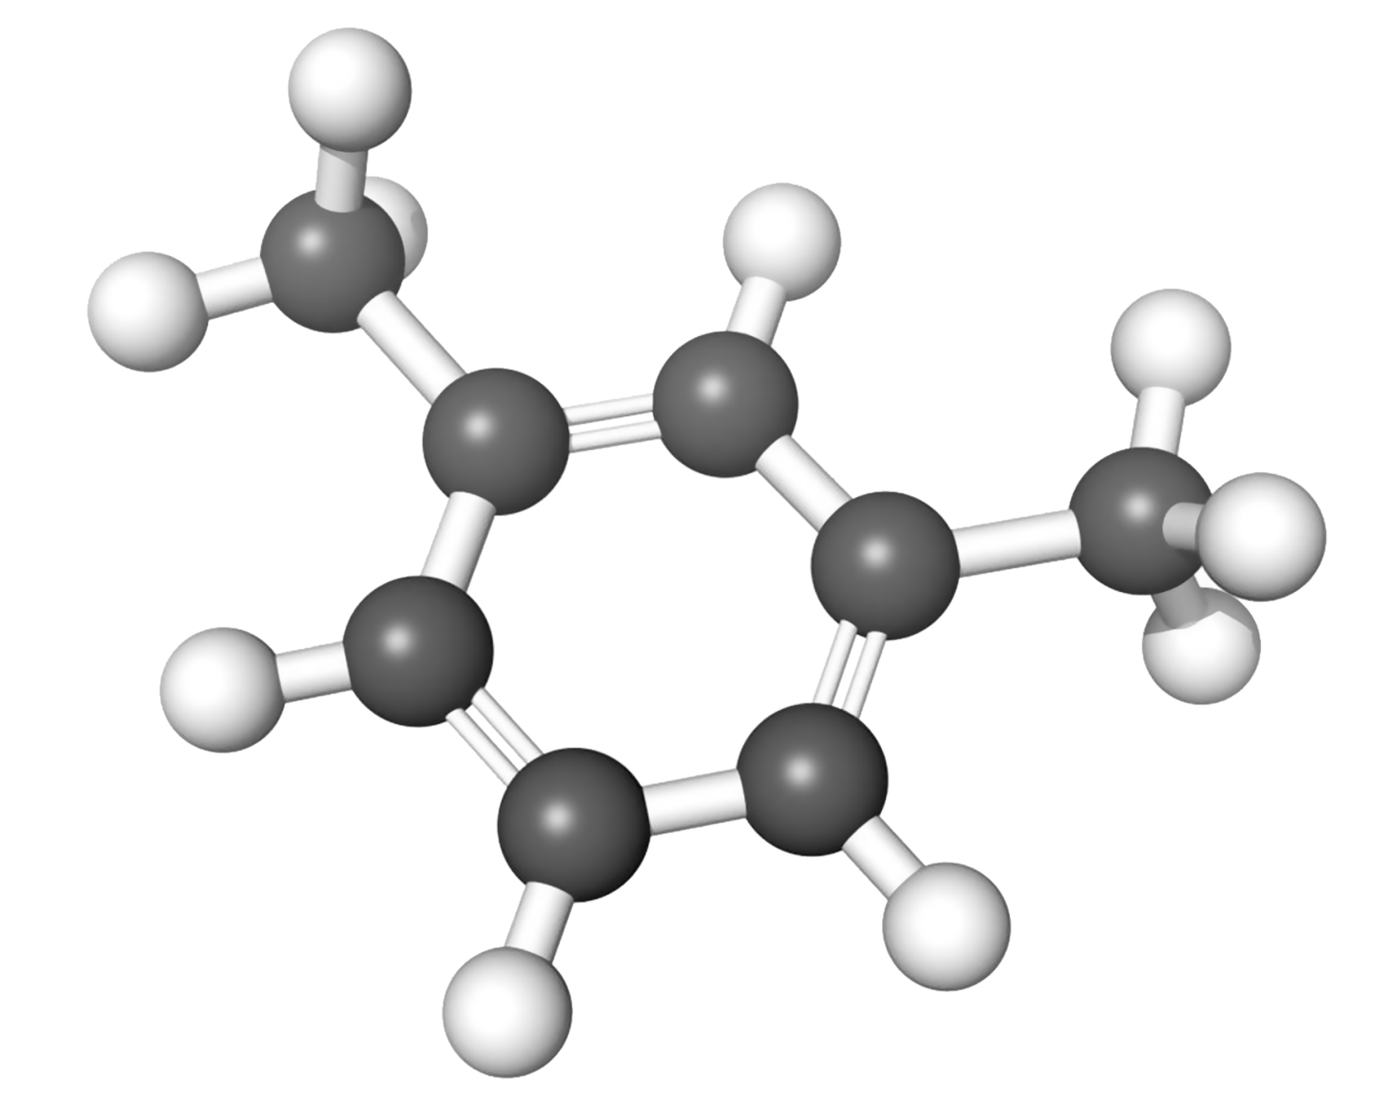
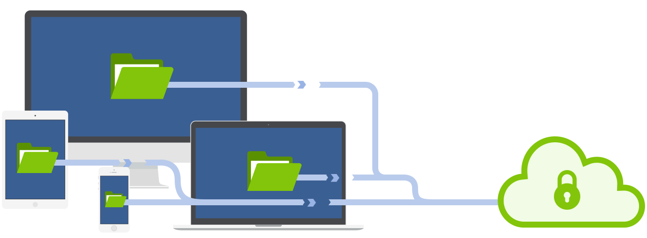
Ingestion EndPoint(s)
Understand how public and internal endpoints will handle requests.
#1
Typical Size of a message? (Average, Max)

Slide 27


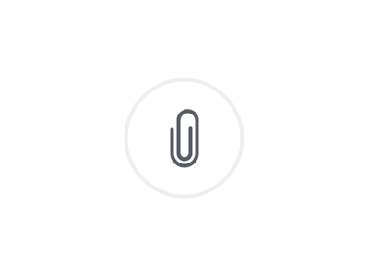
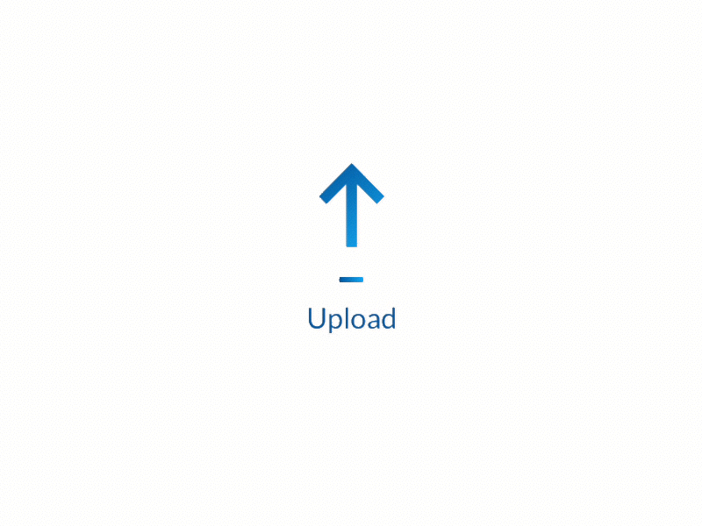
Ingestion EndPoint(s)
Understand how public and internal endpoints will handle requests.
#1
Typical Size of a message? (Average, Max)
Azure IoT Hub 256-KB

Slide 28
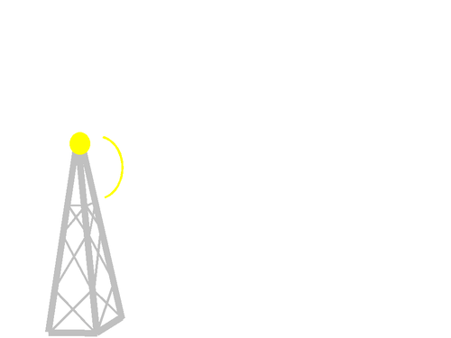



Ingestion EndPoint(s)
Understand how public and internal endpoints will handle requests.
#1
Typical Size of a message? (Average, Max)
#2
Who will send the messages?
Fewer considerations
Device (Continuous)

Slide 29
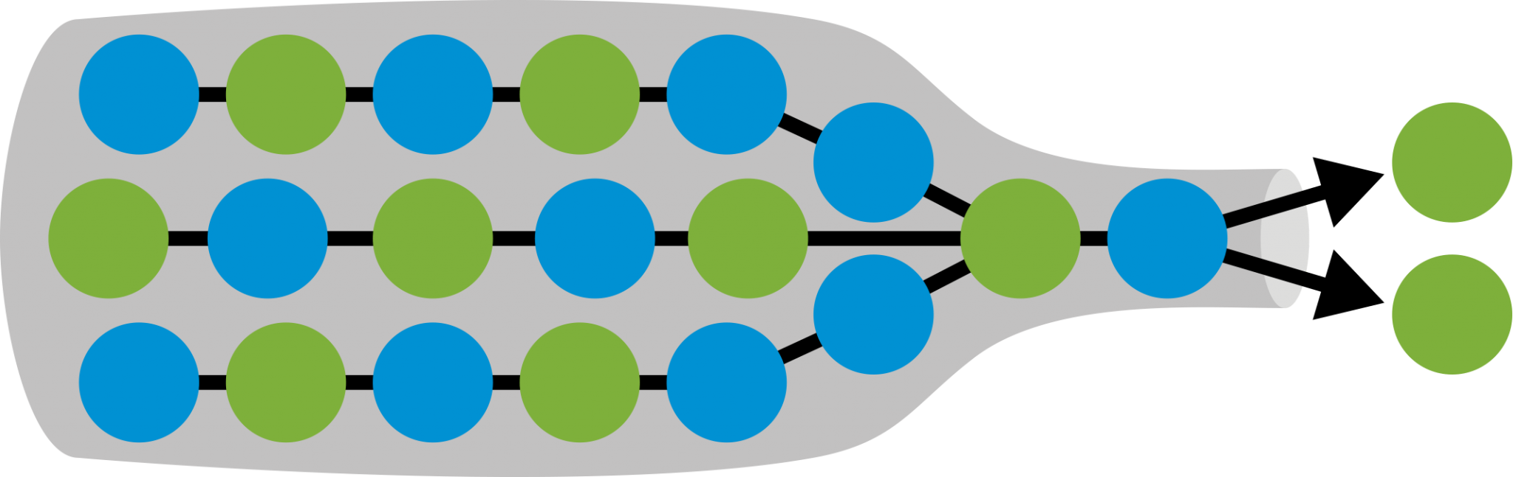
Ingestion EndPoint(s)
Understand how public and internal endpoints will handle requests.
#1
Typical Size of a message? (Average, Max)
#2
Who will send the messages?
Continuous streams of data and reach the throttle of a provider service quickly

Slide 30
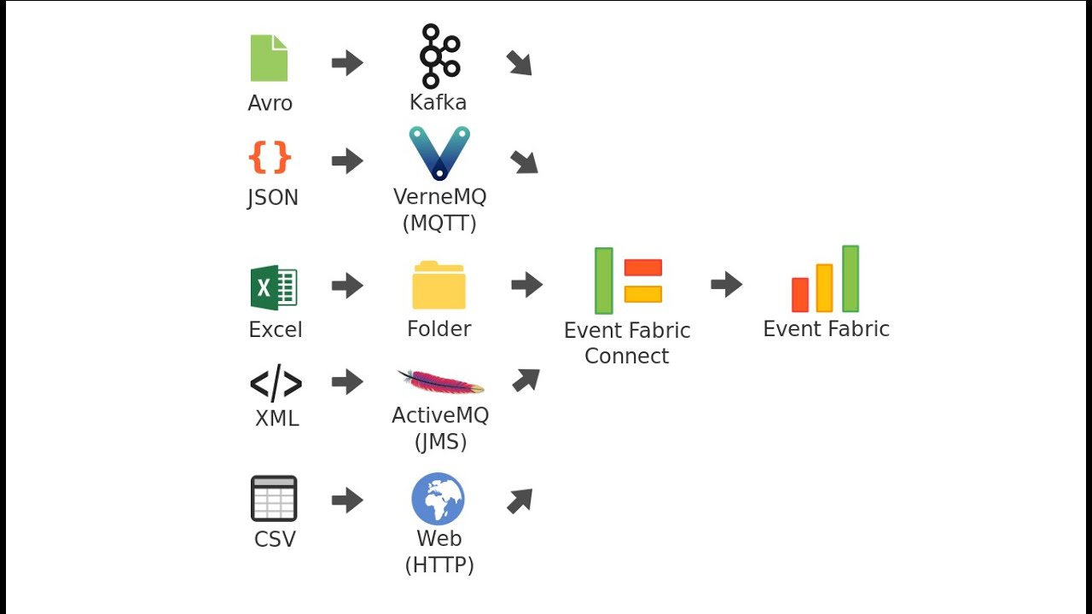
Ingestion EndPoint(s)
Understand how public and internal endpoints will handle requests.
#1
Typical Size of a message? (Average, Max)
#2
Who will send the messages?
#3
What message format(s) are we dealing with?

Slide 31

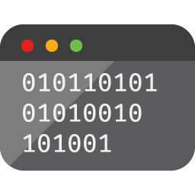


Ingestion EndPoint(s)
Understand how public and internal endpoints will handle requests.
#1
Typical Size of a message? (Average, Max)
#2
Who will send the messages?
#3
What message format(s) are you dealing with?
Azure IoT Hub
Azure Stream Analytics (ASA)

Slide 32
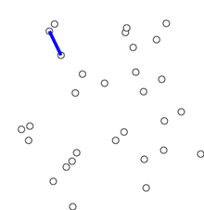

Ingestion EndPoint(s)
Understand how public and internal endpoints will handle requests.
#1
Typical Size of a message? (Average, Max)
#2
Who will send the messages?
#3
What message format(s) are we dealing with?
#4
Protocols required to be able to send data to the cloud
IoT systems have custom protocols instead of the popular HTTP protocol
impact your decision to use a Serverless service

Slide 33
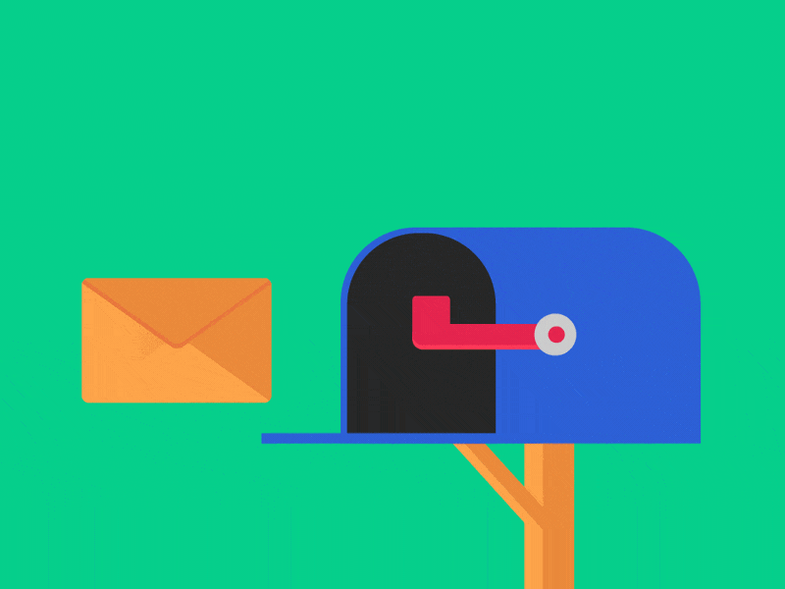
Ingestion EndPoint(s)
Understand how public and internal endpoints will handle requests.
#1
Typical Size of a message? (Average, Max)
#2
Who will send the messages?
#3
What message format(s) are we dealing with?
#4
Protocols required to be able to send data to the cloud
#5
Frequency in which messages are being sent?

Slide 34
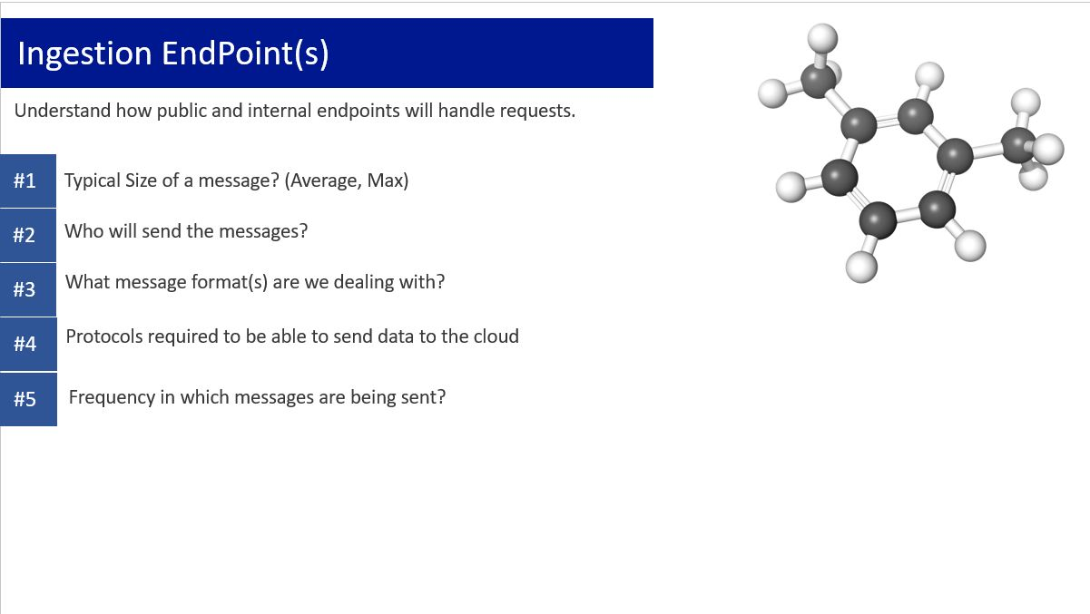
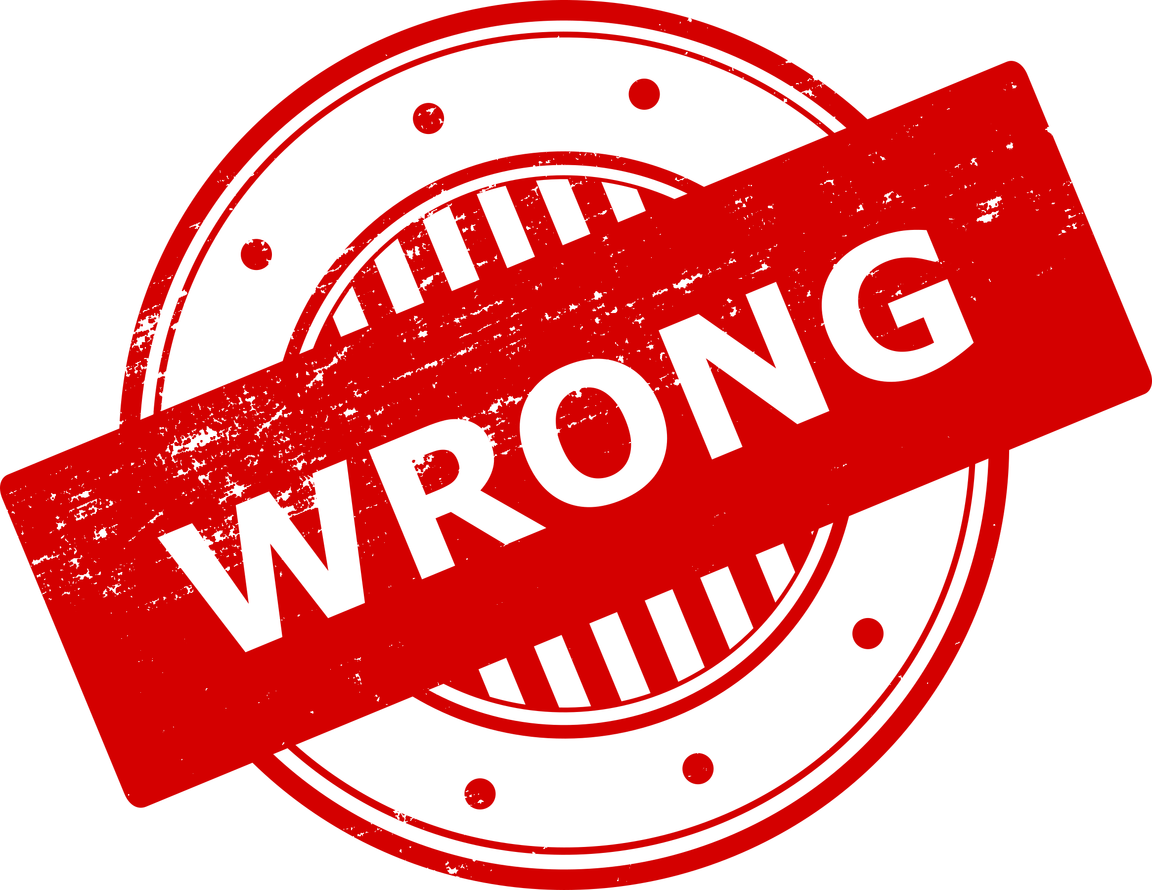

Slide 35

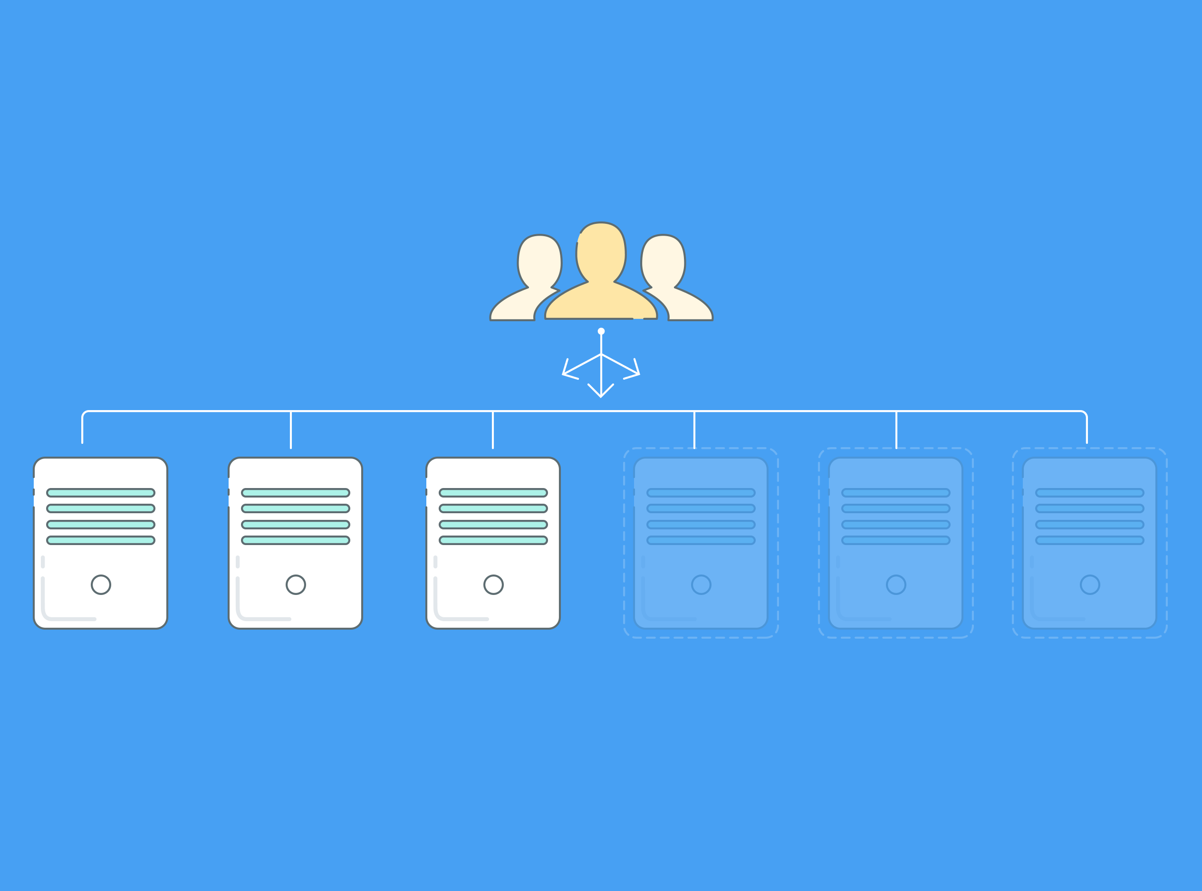

Slide 36
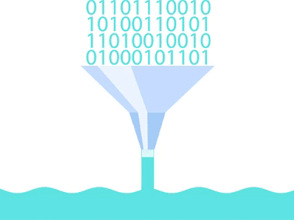
Ingestion EndPoint(s)
Understand how public and internal endpoints will handle requests.
#1
Typical Size of a message? (Average, Max)
#2
Who will send the messages?
#3
What message format(s) are we dealing with?
#4
Protocols required to be able to send data to the cloud
#5
Frequency in which messages are being sent?
How incoming message will impact the units you have allocated for your service

Slide 37
Ingestion EndPoint (s)
1
Ingestion EndPoint(s)
Storage
2
Storage
Security
What usage model do we need?
Availability & DR
Which functionality do we need?
Serverless
Architecture - Planning

Slide 38

Storage
How data is stored and processed by downstream services.
#1
Real Time v/s Batch Routing

Slide 39



Storage
How data is stored and processed by downstream services.
#1
Real Time v/s Batch Routing
Data in motion
Azure Stream Analytics
Records over a period
Azure Time Series

Slide 40
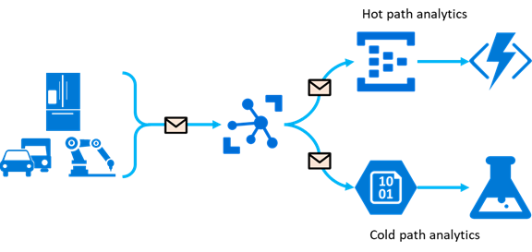
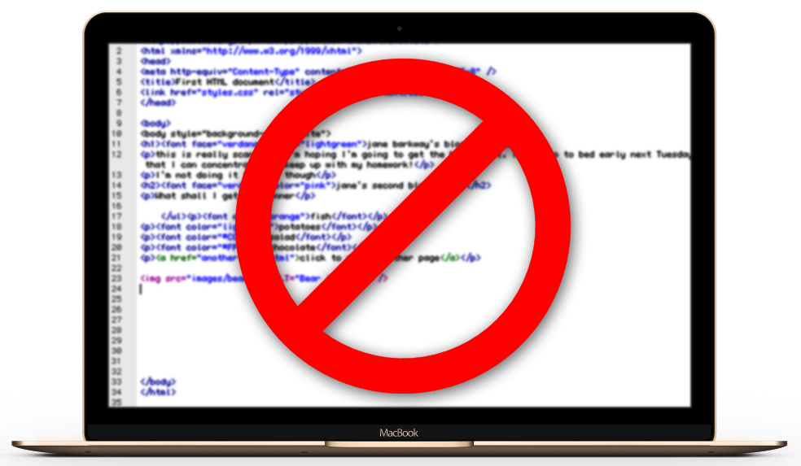
Storage
How data is stored and processed by downstream services.
#1
Real Time v/s Batch Routing
#2
Does the incoming data has any tags to classify / categories data?
Azure IoT Hub
Message Routing

Slide 41
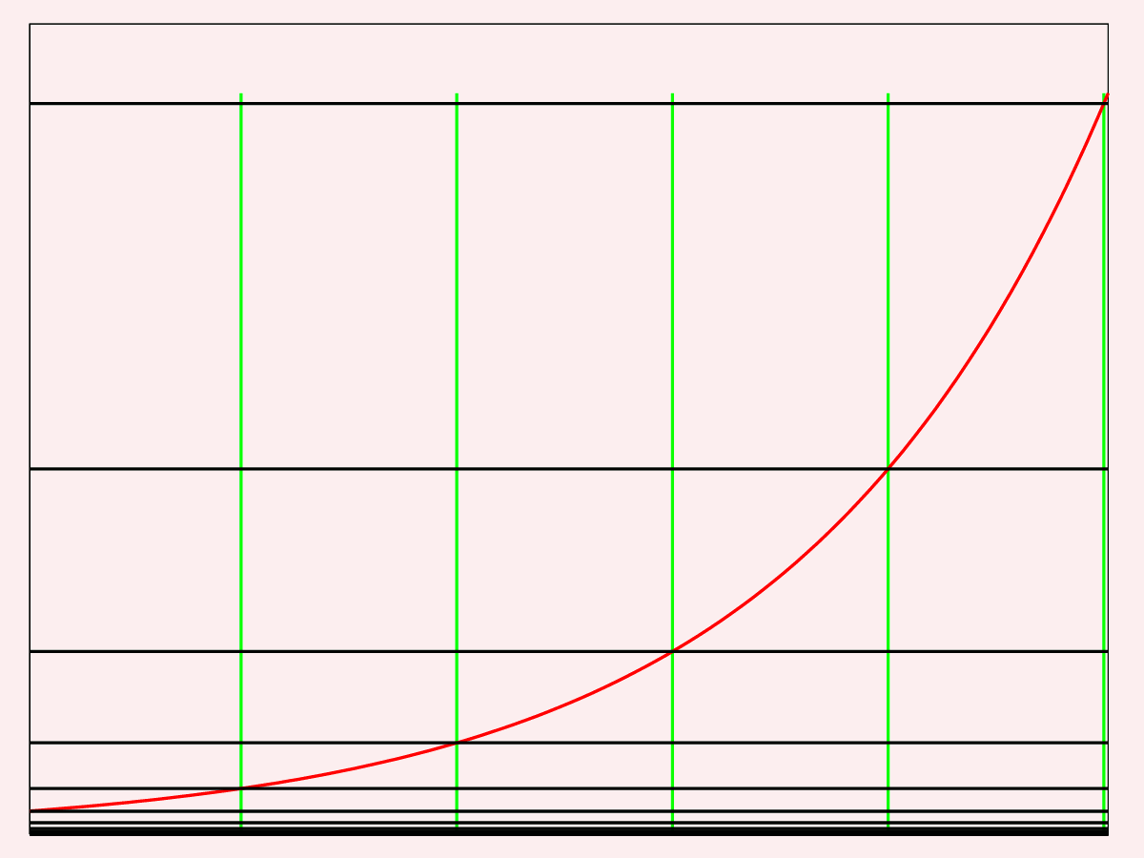
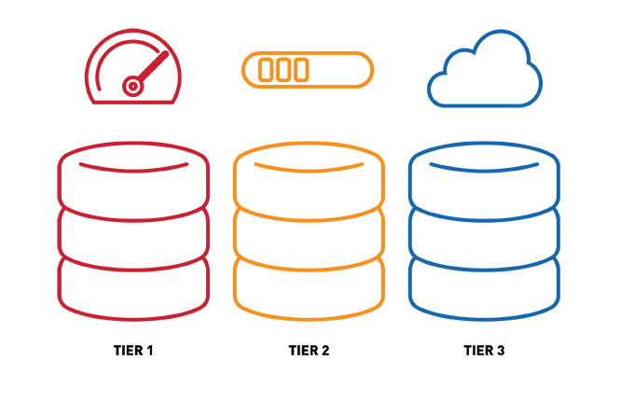
Storage
How data is stored and processed by downstream services.
#1
Real Time v/s Batch Routing
#2
Does the incoming data has any tags to classify / categories data?
#3
Retention Policies and Archival
If data is growing
→
Hot
Cool
Archive Tiers

Slide 42
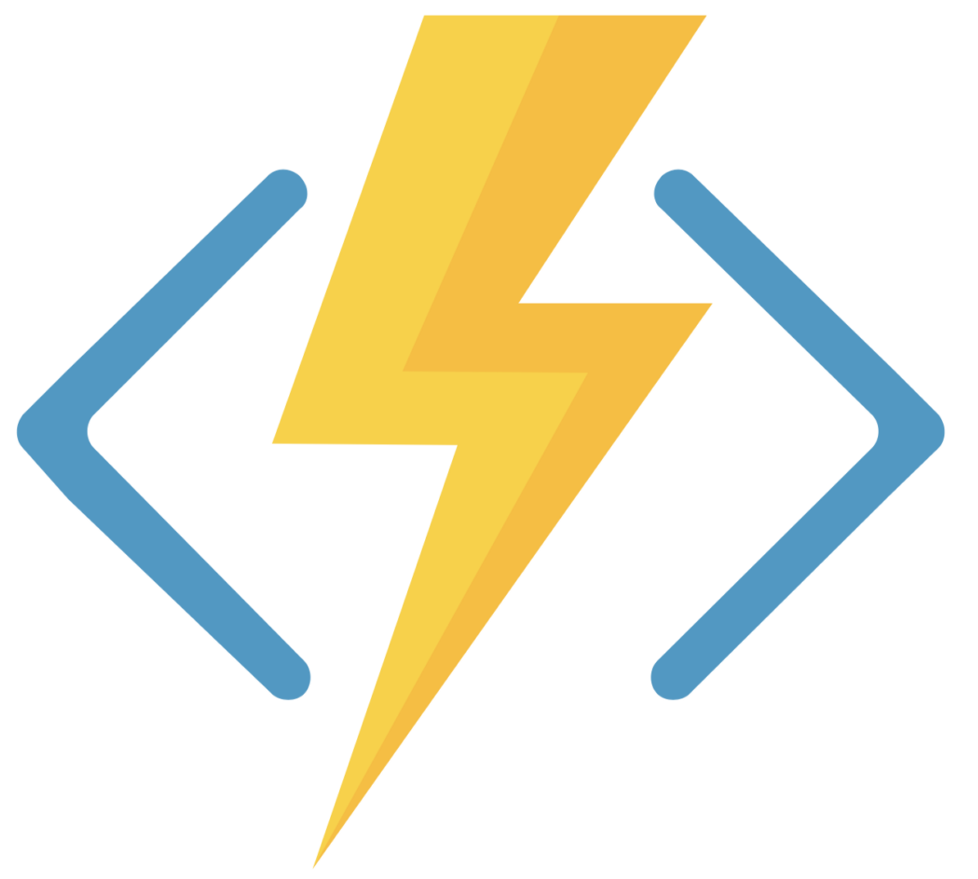
Storage
How data is stored and processed by downstream services.
#1
Real Time v/s Batch Routing
#2
Does the incoming data has any tags to classify / categories data?
#3
Retention Policies and Archival
#4
Storage used by Serverless Compute
→
Blobs & Tables Internal operations
Azure Function performance can be impacted by Storage limits and IOPS

Slide 43



Storage
How data is stored and processed by downstream services.
#1
Real Time v/s Batch Routing
#2
Does the incoming data has any tags to classify / categories data?
#3
Retention Policies and Archival
#4
Storage used by Serverless Compute
Separate them per Function App
Handle logs separately

Slide 44
Ingestion EndPoint (s)
How much control required?
Storage
2
Storage
Security
3
Security
Running app in Azure:
Questions to Ask
Availability & DR
High availability & Disaster Recovery

Slide 45
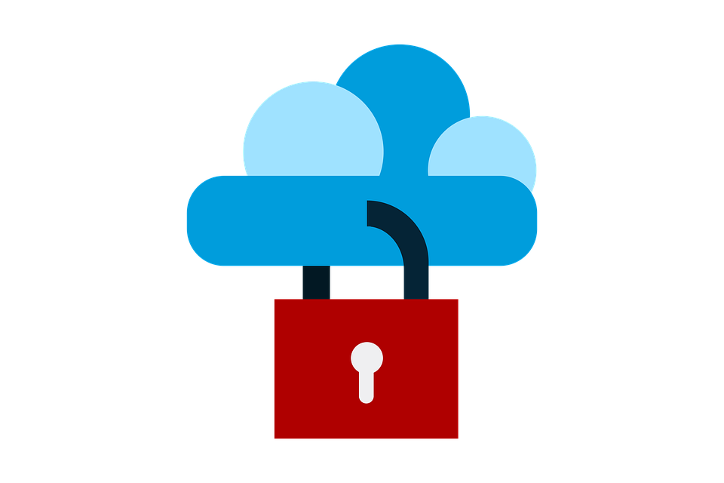
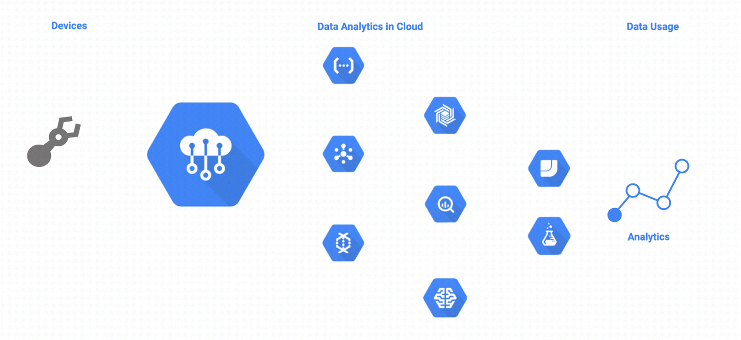
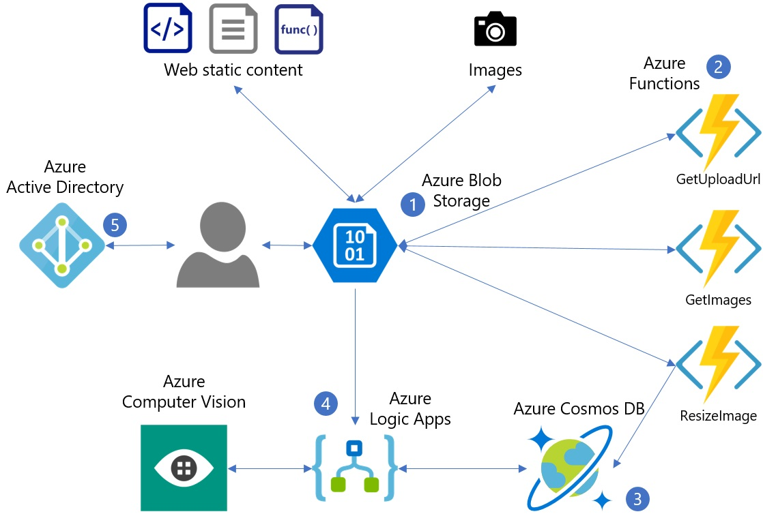
Security
Prevent malicious attacks on your solution
#1
Transport and Messaging
Some of these services may not have public endpoint however they still need to be secured to ensure the end-end protection of services.

Slide 46
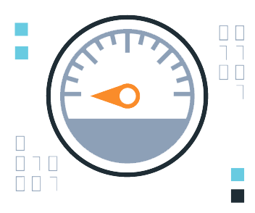
Security
Prevent malicious attacks on your solution
#1
Transport and Messaging
#2
Encryption and Encoding
Message size will increase and can impact overall persistence targets as well as response times because of encrypting/decrypting and encoding/decoding procedures.

Slide 47
Ingestion EndPoint (s)
How much control required?
Where do we need to put application to run?
Storage
3
Security
Security
Running app in Azure:
Questions to Ask
Availability & DR
4
Availability & DR

Slide 48

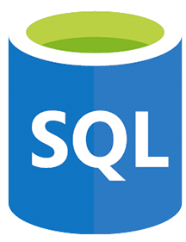

Availability & DR
Technically, most of it is taken care by Serverless
#1
Data Replication
Provide geo-replication →
These can be enabled to ensure that all data at rest can be moved to a different paired region and is available in case of a data centre failure.

Slide 49
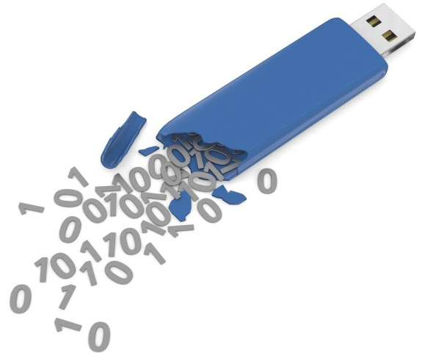
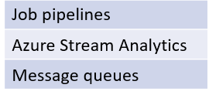
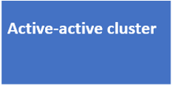
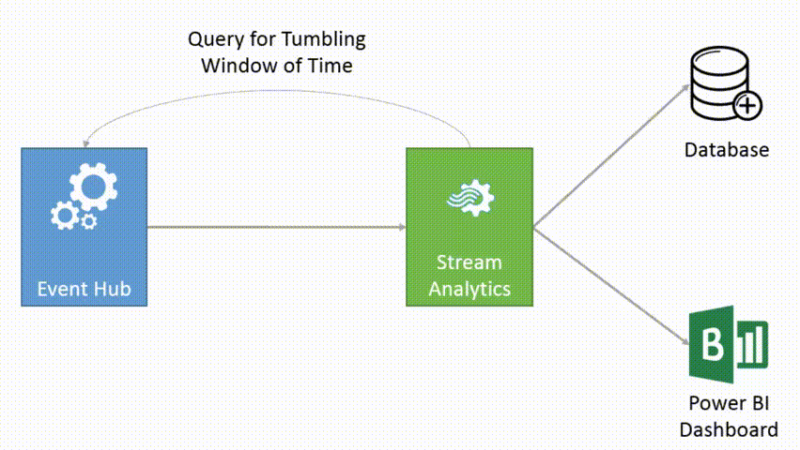
Availability & DR
Technically, most of it is taken care by Serverless
#1
Data Replication
#2
In-stream Processing
Almost no message replication

Slide 50

Availability & DR
Technically, most of it is taken care by Serverless
#1
Data Replication
#2
In-stream Processing
#3
Service Availability
Ensure that the services that your leveraging are available in paired regions
Azure Application Insights

Slide 51
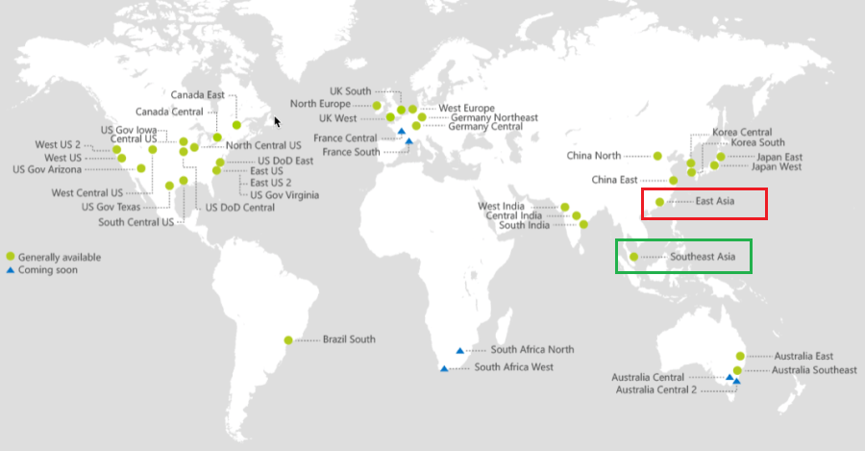
Availability & DR
Technically, most of it is taken care by Serverless
#1
Data Replication
#2
In-stream Processing
#3
Service Availability

Slide 52



Thank you.

Slide 53
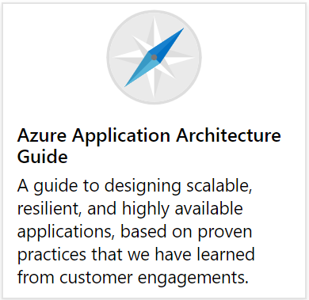
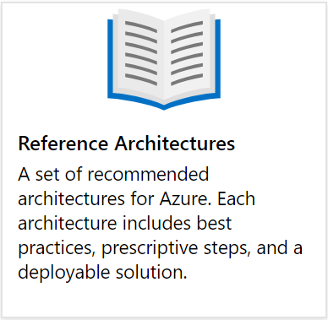
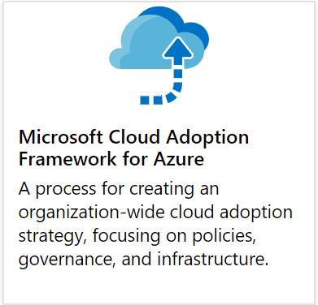
Reference material
Azure Architecture Center
https://docs.microsoft.com/en-us/azure/architecture

Slide 54
Reference material
Azure Architecture Center
https://docs.microsoft.com/en-us/azure/architecture

